Slide 1
Green infrastructure: adressing problems by smart use of natural processes
Ladislav Miko
European Commission
DG Environment
Directorate B: Nature, Biodiversity and Land Use

Slide 2
EU biodiversity policy
European biodiversity policy: 2 basic directives (‘Birds’ and ‘Habitats’: Natura 2000) + set of other policy measures (WFD, EIA/SEA, CAP, CFP…)
Biodiversity target 2010: Halt the loss
2006 BAP adopted
Several important achievements (increase in populations of most endangered birds, large carnivores, efficient protection of some endemics and highly specialised species etc.)
Nevertheless, target as a whole NOT REACHED

Slide 3
EU biodiversity policy - present
Shift from species/habitats to broader ecosystem approach
Functional ecosystems – base for delivery of ecosystem services (MA)
High value in economic terms documented by TEEB (recognize-demonstrate-capture)
Biodiversity - basic structural component of ecosystems: link between biodiversity and ecosystem health assumed (…and still not well documented)
Drivers of biodiversity loss (habitat destruction, overexploitation, fragmentation, pollution, invasive species…) not declining, growing importance of climate change

Slide 4
New EU biodiversity policy
2010: new EU biodiversity vision and post-2010 target adopted
Reflecting lessons learned from previous period:
Conservation/protection approaches only are not sufficient, need to restore
Ecosystems and ecosystem services much more emphasized: delivery of different functions as a key

Slide 5
2020 target and subtargets
Headline of new biodiversity target:
“To halt the loss of biodiversity and the degradation of ecosystem services in the EU by 2020, restore them insofar as feasible, while stepping up the EU contribution to averting global biodiversity loss.”
Limited set of well defined and focused sub-targets:
ST1 Integration and sustainable use of resources
ST2 Overexploitation
ST3 Fragmentation and Green Infrastructure
ST4 Invasive species
ST5 Nature Conservation (NATURA 2000)
ST6 Contribution to global biodiversity

Slide 6
Links to restoration agenda
In principle, all subtargets have a restoration component
Nevertheless, two of them are more directly linked: overexploitation (degradation of ecosystems) and fragmentation
Green Infrastructure developed as a key approach to adress both ecosystem services and connectivity

Slide 7
Different perspectives
Where the restoration comes from?
We want to get particular species, communities and (healthy) ecosystems back
Delivery of ecosystem services is secured by presence of healthy, resilient ecosystems
But reverse angle of view is also possible – may be much more acceptable in policy!
“Technological view” – see the ecosystems as (Green) infrastructure necessary for delivery of certain services
RESTORATION
SERVICES
as ‘by-product’
ECOSYSTEM
SPECIES
COMMUNITIES
SERVICES
RESTORATION
ECOSYSTEM
SPECIES
(as precondition or as consequence)

Slide 8
Green Infrastructure - concept
To secure long-term (sustainable) delivery of ecosystem goods and services, by working with nature
Cheap, self-sustaining, resilient
Not (or very little) dependent on oil/other sources of energy added by man (automatic)
Delivering solutions for climate change mitigation and adaptation
Minimizing natural disaster risks

Slide 9
Green infrastructure - approach
Strategic restoration, using limited land available in Europe:
Identify needs and options (multiple versus uniform services etc.)
Select functions to be delivered
Identify appropriate part of land and restore
Facing fragmentation, simplification and unification – need to restore functional (and consequently also structural) complexity:
Energy availability
Material availability
Call for integrated spatial planning approach
KEY ROLE OF SOIL

Slide 10
Green infrastructure – approach (2)
European Green Infrastructure policy – high added value:
Territorial complexity: toolbox to promote international, cross-border initiatives, delivering functions at higher hierarchical levels (regional, continental)
Cross-policy complexity: integration of many sectors involved – agriculture, forestry, water framework, carbon, coastal and marine,fisheies, urban and peri-urban (regional development)

Slide 11
Possible (non-biodiversity focused) deliveries of Green Infrastructure
Many examples, used already but often unconsciously or not integrated:
Flood prevention and management
Coastal protection
Fish-stock restoration
Water retention
Water purification
Carbon storage (living biomass)
Soil protection (erosion, land slides)
Soil regeneration (C storage – dead organic matter, prevention of nutrient loss & eutrophication)
Microclimate management & energy saving
Air filtering
Waste absorbing capacity – waste degradation

Slide 12
“Nihil novi sub sole”
Idea not new, used for centuries, but often without detailed knowledge of principle
Examples:
Use of parks and plants to mitigate microclimate (alleys, yards shaded by plants)
Natural water purification, worked for centuries (often non-conscious use)
Soil regeneration: use of fallow, manure fertilizing
Intentional use of fire (fire-driven ecosystems) to prevent wild fires

Slide 13
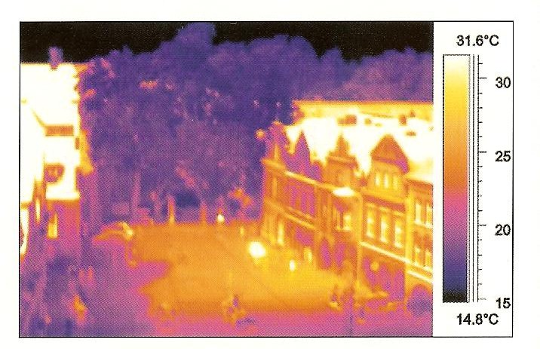
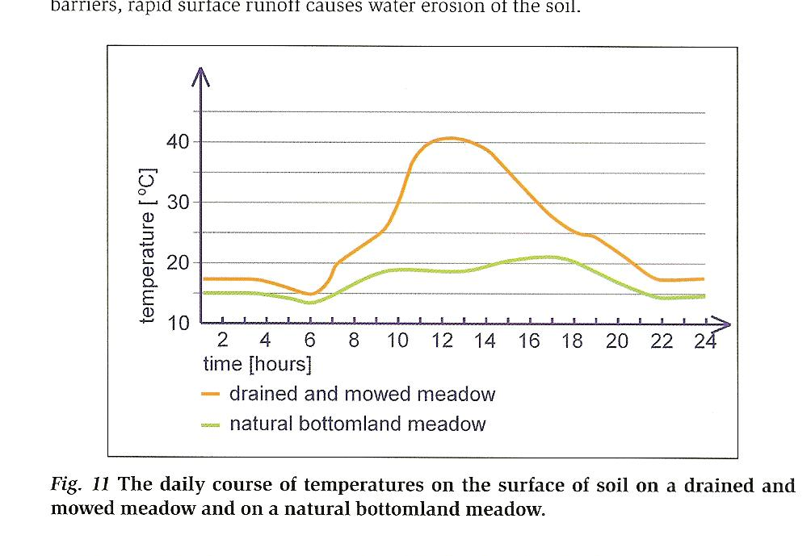
Microclimate management
Parks, green roofs, green walls: cooling effect of vegetation in urban areas (evapotranspiration)
Energy savings (air conditioning)
Similar effects possible in non-urban landscape
Support of small water cycle (link to water availability)

Slide 14
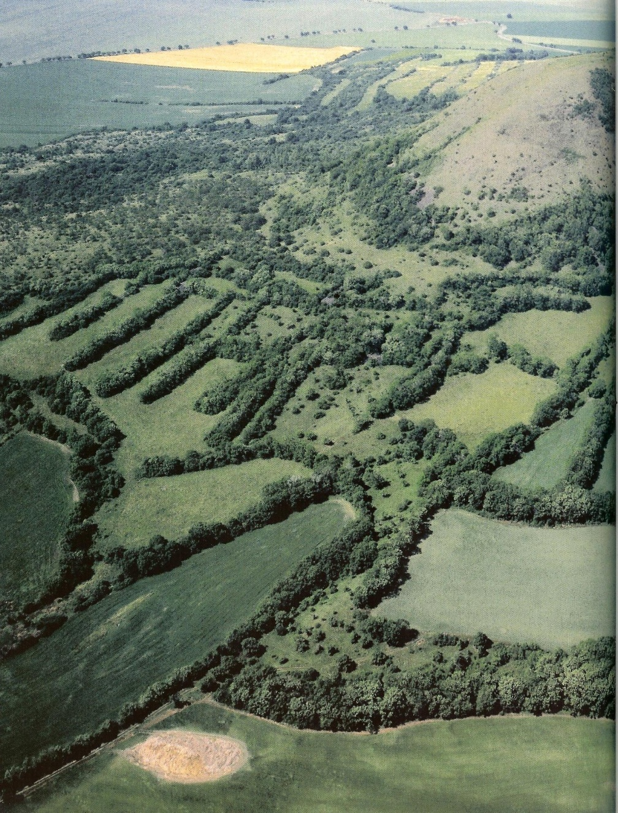
Soil protection (erosion, land slides)
Protection of fertile soil for agriculture
Prevention of nutrient loss
Prevention and minimisation of human health/lives
Prevention and minimisation of material damages
No or very little efficient substitutes to ecosystem function, all very expensive

Slide 15
Soil regeneration: problem of food
Harvest
Ploughing
Pesticides
Herbicides
Compacting
Irrigation
Complex structure
Lower production/year
Fully driven by solar energy
Simplified structure, degraded
Higher yield per year
Dependent on oil/human added energy

Slide 16
Soil regeneration: reversing nutrients loss, preventing eutrophication
mineral
fertilizers
nutrient loss
Nutrients recycled, available, kept
Some may be limiting
Human indepndent
Dependent
on humans,
Expansive,
Causing
eutrophication

Slide 17
Soil regeneration: water regime
Differences in water retention and availability
Aerial effect: flooding prevention
Temperature buffering

Slide 18
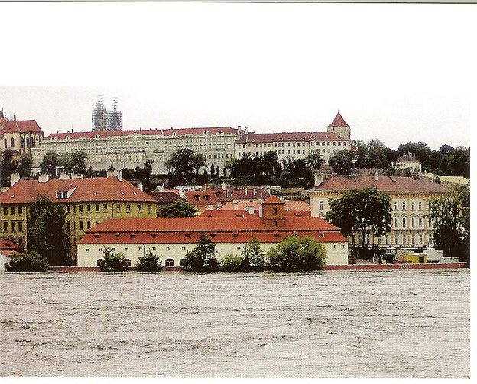
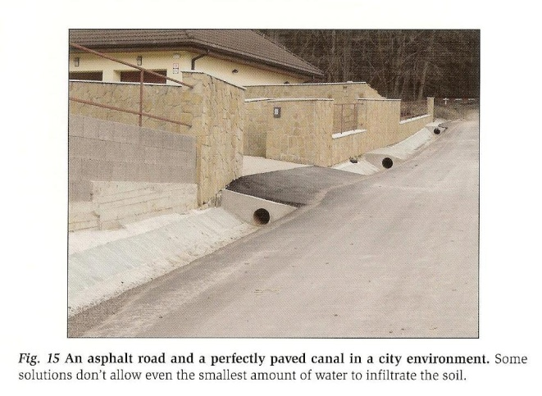
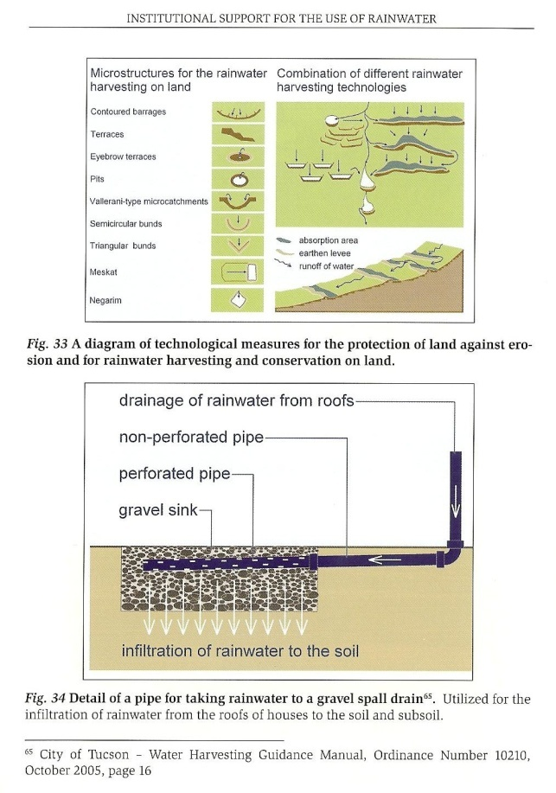
Flood prevention and water retention
Slowing down water run-off
Keeping water in soil profile (available for plants and other biota)
Prevention/minimisation of (excessive) damages
Support to small water cycle, (micro-)climatic impacts – CC mitigation/adaptation

Slide 19
Smart solutions: parallel benefits
Biodiversity:
Connectivity
Ecosystem resilience
New habitats/ support to species
Counteraction to invasive species
Social:
Green economy, new jobs
Well-being
Health
Heritage

Slide 20
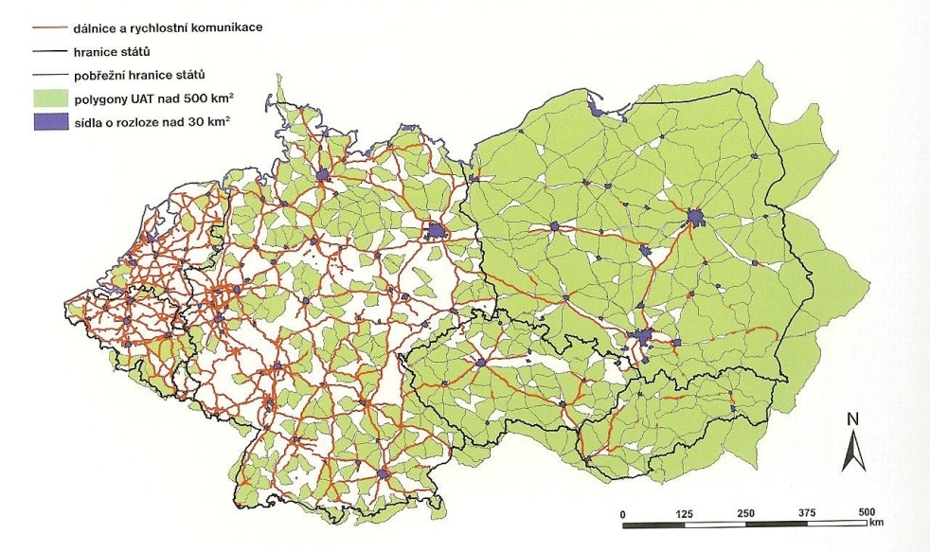
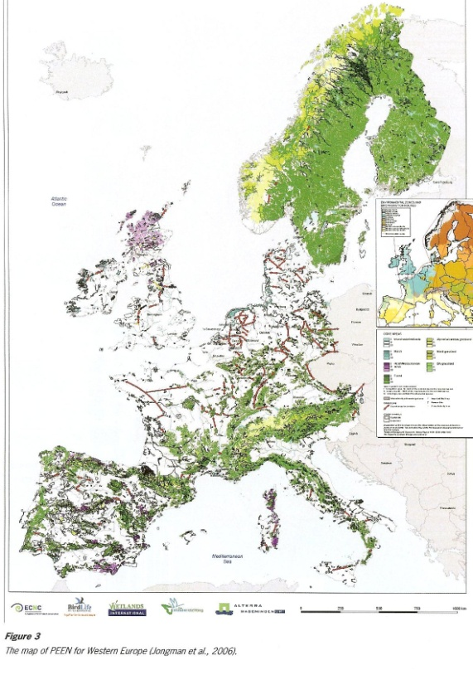
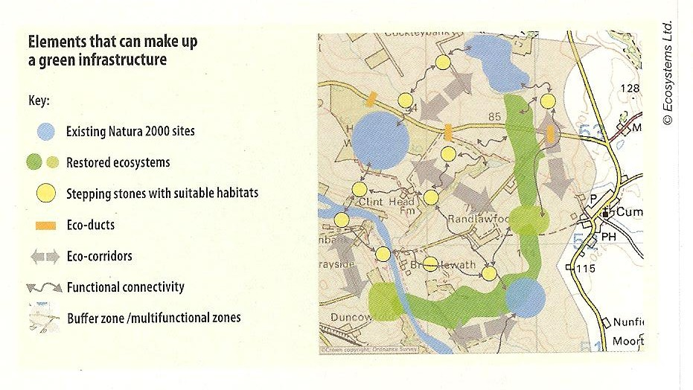
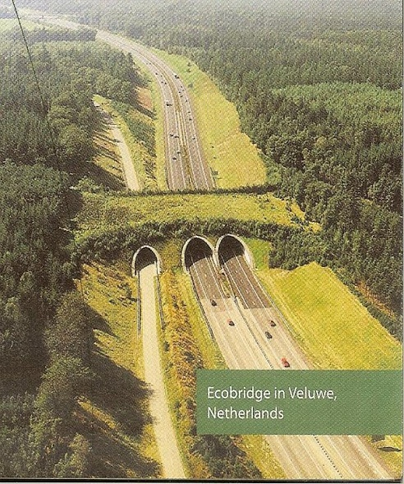
Classical Green Infrastructure: biodiversity support
Adressing fragmentation
Increasing connectivity
Ecological networks, ecoducts, stepping stones etc.

Slide 21
Green Infrastructure – ways of financing at EU level
Current revision of EU funding instruments provides opportunity
Regional policy – stopping biodiversity loss (biodiversity proofing?):
EU Regional Development Fund to finance restoration and big investments to infrastructure development
European Social Fund to finance working/job opportunities in building Green Infrastructure
CAP reform – payments for public goods/services:
CFP – marine restoration to be included
LIFE – co-financing possibilities for what is impossible elsewhere
Same effect may be many times achieved cheaper compared to technological/technical solutions

Slide 22
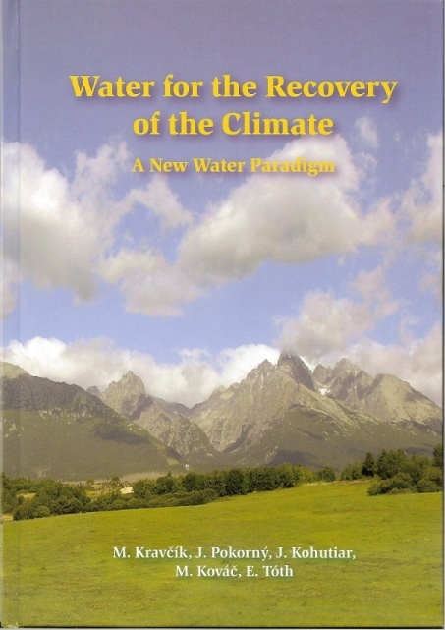
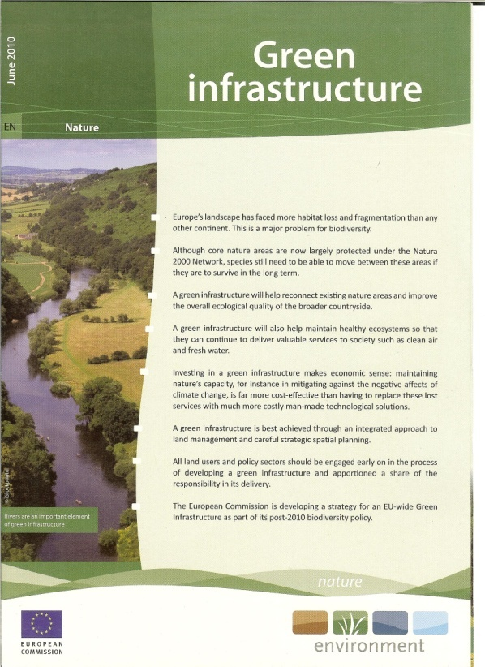
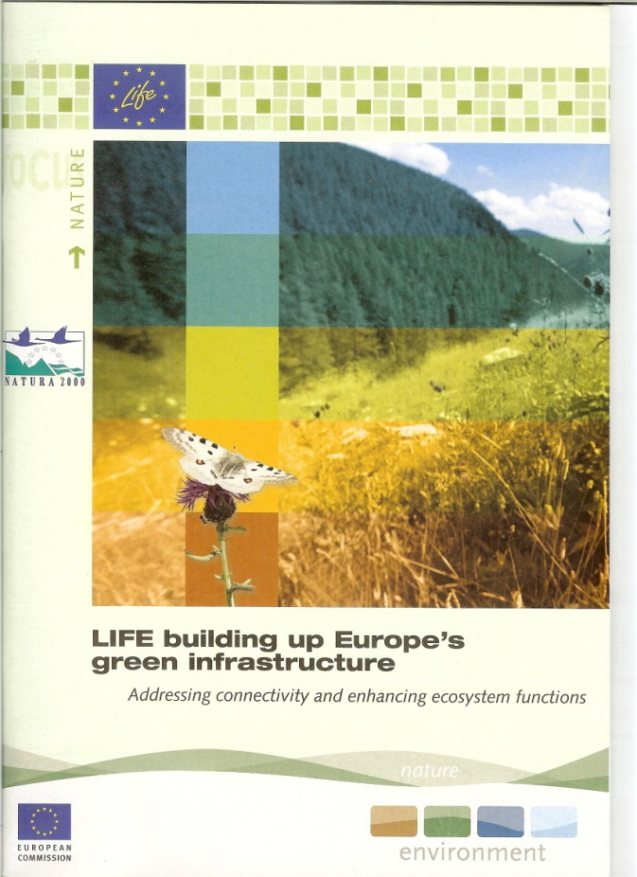
Conclusions
Restoration will be one of corner stones of new EU biodiversity strategy
Green Infrastructure is proposed tool to ensure sustainable delivery of ecosystem services, while supporting biodiversity
Functional/ecosystem services approach may be more accepted and understood as primarily biodiversity oriented approaches
There is a need to demonstrate the services supported/delivered by restoration activities (presentation, communication to non-biodiversity audience!)

Slide 23
PROTECT
RESTORE
spp/habitats processes/services
Here we are…
CREATE
WILD
CLOSE TO NAT.
EXTENSIVE
INTENSIVE
(SUB-) URBAN

Slide 24
y
H
x
(A)
(B)
L
WILD
CLOSE TO NAT.
EXTENSIVE
INTENSIVE
(SUB-) URBAN

