Slide 1
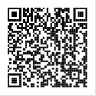
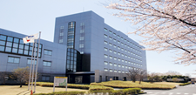
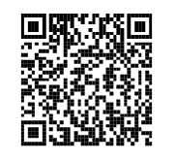
For Ph.D. Students
NIMS International
Cooperative Graduate
Program
CALL FOR APPLICATIONS
Opportunities for International Collaboration
at NIMS, JAPAN Available
Application Deadline: January 6, 2023
To apply, find out your university contact:
NIMS will provide the following support
for successful applicants.
・Living Allowance
・Furnished Accommodation
Doctoral students can conduct part of their thesis work for six months to a year with co-supervision by the NIMS researchers.
NIMS Official Website:
National Institute for Materials Science, Japan

